Slide 1
Learn – Explore - Debate
#LEDevents
ncb.org.uk

Slide 2
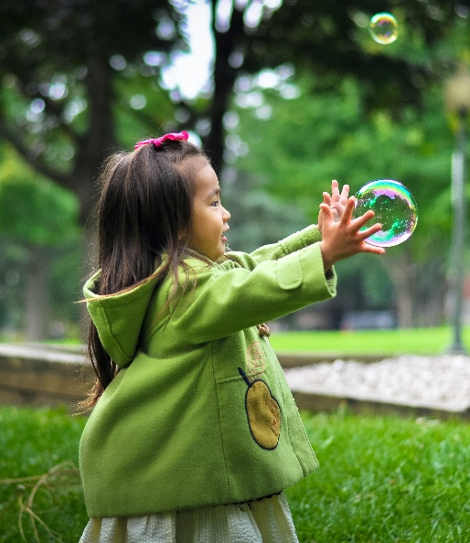
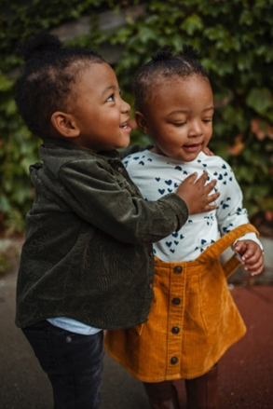
Where are we now……?
Young children have spent a considerable amount of their lives spent during the pandemic…..
BORN
in a PANDEMIC
2 year old and younger 100%
3 year old 75%
“No job is more important than working with children in the early years.”
Development Matters, 2021
4 year old 50%
5 year old 40%
#LEDevents

Slide 3
Reflection on challenging times
Thank you for your continued…
provision of excellent care and education during the most challenging of times
ongoing support to parents to provide children with the best possible start
care and support of each other’s wellbeing
“No job is more important than working with children in the early years.”
Development Matters, 2021
#LEDevents

Slide 4
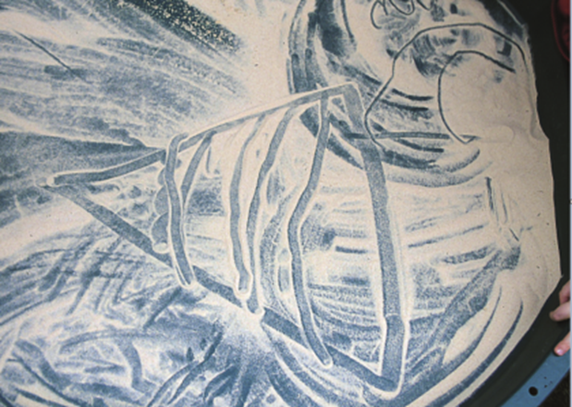
NCB continues to work to raise the profile of the early years, supporting children, families and early years professionals through
Our role as DfE’s strategic partner to
improve practitioner knowledge, skills and confidence
listen to the sector and facilitate healthy debate between DfE and the sector
Bringing people and organisations together to drive change in society and deliver a better childhood across the UK
#LEDevents

Slide 5
Keep up to date and get in touch via…
foundationyears.org.uk
@FoundationYears
foundationyears@ncb.org.uk
#LEDevents

Slide 6
Agenda
Department for Education
EYFS Reforms
COVID-19 recovery
Assessment under the revised EYFS
Ofsted
Inspections under the revised EYFS
#LEDevents

